Slide 1
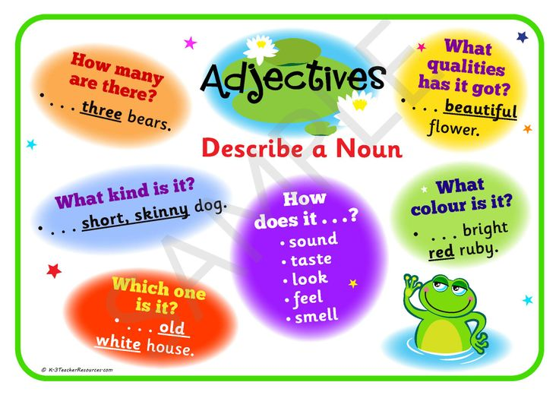
ADJECTIVES

Slide 2
2. ADJECTIVES HAVE 3 DEGREES
1. ADJECTIVES ARE OF 5 KINDS…

Slide 3
THE FIVE KINDS OF ADJECTIVES ARE:-
1. Descriptive adjective or adjective of quality
EXAMPLES
• dangerous chemicals
• green vegetables
• a square box
• a big house
• a tall tree
• a cold morning
• a true story
• English language

Slide 4
THE 2ND AND 3RD KIND OF ADJECTIVES ARE:-
2. Adjective of quantity
He has eaten three apples.
I don’t have much money.
There is so much wine for the guests.
This long, thin centipede has many legs.
3. Demonstrative adjective
This red balloon is mine and those three yellow ones are yours.
.This cute baby is his brother. That cute baby is his sister.

Slide 5
4.Possessive adjective
Example:
I spent my afternoon cleaning the toilet.
This must be your cap.
His arms have a few tattoos.
Its skin is dry and rough.
Our grandmothers were classmates.
5.Interrogative Adjective
Example:
- Which animal do you like?
- What food do you prefer?

Slide 6
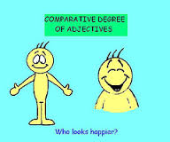
Now we come to the second part:-
The degrees of comparison or adjectives

Slide 7
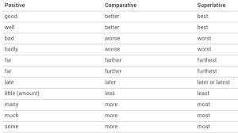
Here are a few adjectives

